Slide 1
Data Warehousing Fundamentals
Enterprise Data Warehouse
LEVEL – LEARNER

Slide 2





Icons Used
Questions
Hands on Exercise
Summary
Test Your Understanding
Reference

Slide 3



Data Warehousing Fundamentals
Now lets take a look at how the Enterprise Data Warehouse is designed and what approaches are followed.

Slide 4







Content Overview
In this session, we would talk about the Enterprise Data Warehouse and the approaches followed to develop EDW. We would also cover the pros and cons of the approaches involved.
Enterprise Data Warehouse Definition
Top- Down Approach of EDW
Bottom-Up Approach of EDW
Enterprise Data Warehouse
Implementation of Top-Down Approach
Implementation of Bottom-Up Approach
Pros and Cons of both Approaches

Slide 5

Objectives
Through this chapter you will be able to understand:
What is a Enterprise Data Warehouse?
What is Top-Down Approach?
What is Bottom-Up Approach?
How are the two approaches different?
What are the pros and cons of
each approach?

Slide 6

Enterprise Data Warehouse
Let me explain what is an Enterprise Data Warehouse and what are its features?
An Enterprise Data Warehouse (EDW) contains detailed as well as summarized data.
Separate subject-oriented database.
Supports detailed analysis of business trends over a period of time.
Used for short- and long-term business planning and decision making covering multiple business units.

Slide 7
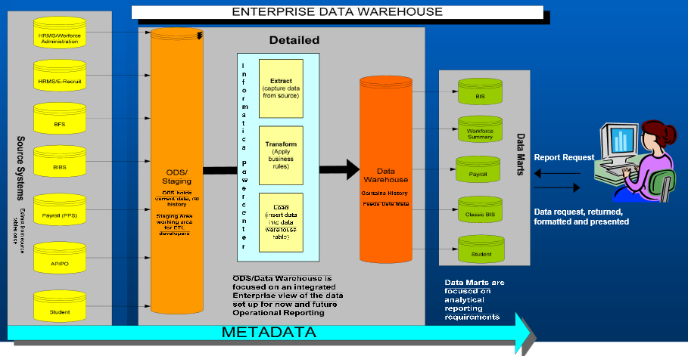
Overview of EDW

Slide 8
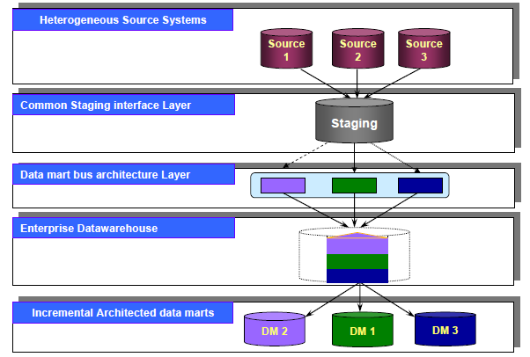
EDW- “Top Down” Approach

Slide 9
EDW - “Top Down” or Inmon’s Approach: Implementation
An EDW is composed of multiple subject areas, such as Finance, Human Resources, Marketing, Sales, Manufacturing, and so on.
In a top down scenario, the entire EDW is architected, and then a small slice of a subject area is chosen for construction.
Subsequent slices are constructed, until the entire EDW is complete.

Slide 10
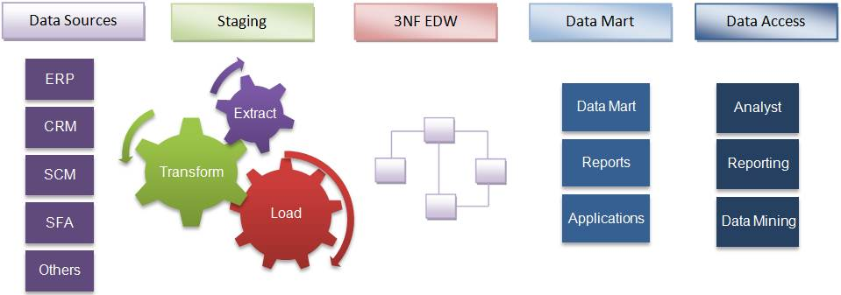
EDW - “Top Down” Approach: Implementation Contd..
A normalized data model is designed first. Then the dimensional data marts, which contain data required for specific business processes or specific departments are created from the data warehouse.

Slide 11
Pros and Cons of Top-Down Approach
The pros of a “Top Down” approach are:
Coordinated environment
Single point of control & development
The cons of a “Top Down” approach are:
“Cross everything” nature of enterprise project
Analysis paralysis
Scope control
Time to market
Risk and exposure

Slide 12
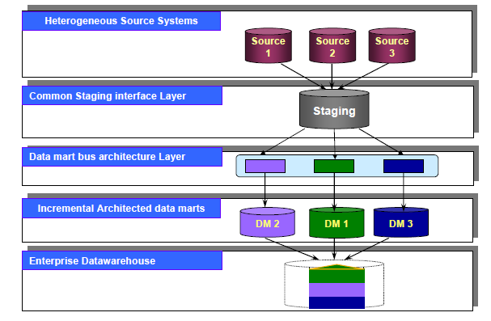
EDW- “Bottom up” or Kimball’s Approach

Slide 13
EDW- “Bottom Up” Approach: Implementation
Initially an Enterprise Data Mart Architecture (EDMA) is developed.
Once the EDMA is complete, an initial subject area is selected for the first incremental Architected Data Mart (ADM).
The EDMA is expanded in this area to include the full range of detail required for the design and development of the incremental ADM.

Slide 14
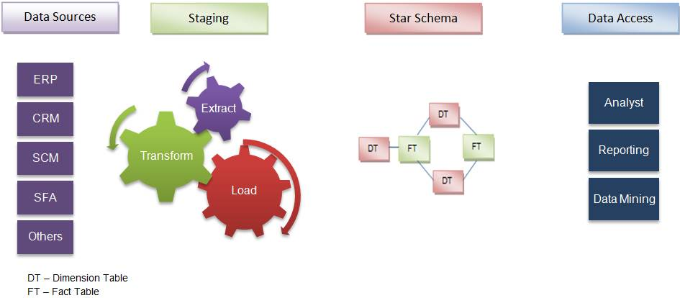
EDW- “Bottom Up” Approach: Implementation Contd..
The data marts facilitating reports and analysis are created first; these are then combined together to create a broad data warehouse.

Slide 15
Pros and Cons of Bottom Up Approach
The pros of a “bottom up” approach are:
Quick Return On Investment (ROI)
Low risk, low political exposure learning and
development environment
Lower level, shorter-term political will be required
Fast delivery
Focused problem, focused team
Inherently incremental
The cons of a “bottom up” approach are:
Multiple team coordination
Must have an EDMA to integrate incremental data marts

Slide 16
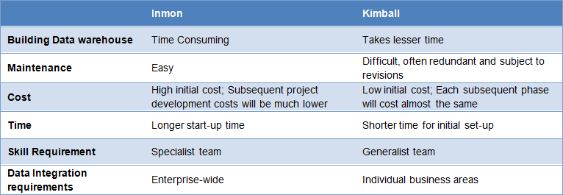
Pros and Cons in nutshell

Slide 17

How to Decide the Approach
How to decide which approach needs to be used?
The approach to designing a data warehouse depends on:
The business objectives of an organization
Nature of business
Time and cost involved
The level of dependencies between various functions

Slide 18
How to Decide the Approach- Examples
Insurance: It is vital to get the overall picture with respect to individual clients, groups, history of claims, mortality rate tendencies, demography, profitability of each plan and agents, etc. All aspects are inter-related and therefore suited for the Inmon’s approach.
Marketing: This is a specialized division, which does not call for enterprise warehouse. Only data marts are required. Hence, Kimball’s approach is suitable.
CRM in banks: The focus is on parameters such as products sold, up-sell and cross-sell at a customer-level. It is not necessary to get an overall picture of the business. Since the scope is limited, you can go for Kimball’s method. However, if the entire processes and divisions in the bank are to be linked, the obvious choice is Inmon’s design.
Manufacturing: Multiple functions are involved here, irrespective of the budget involved. Thus, where there is a systemic dependency as in this case, an enterprise model is required. Hence Inmon’s method is ideal.

Slide 19

Test Your Understanding
What are the two approaches to develop an EDW?
How do we decide which approach to be used while developing an EDW?
What are the basic differences between the two approaches?

Slide 20
Questions

Slide 21
References
Data warehousing Guide - Ralph Kimball
http://searchbusinessintelligence.techtarget.in/tip/Inmon-vs-Kimball-Which-approach-is-suitable-for-your-data-warehouse
Disclaimer: Parts of the content of this course is based on the materials available from the Web sites and books listed above. The materials that can be accessed from linked sites are not maintained by Cognizant Academy and we are not responsible for the contents thereof. All trademarks, service marks, and trade names in this course are the marks of the respective owner(s).

Slide 22
Data Warehousing Fundamentals
Thank you

Slide 23
Change Log
Version Number | Changes made
 | Initial Version | CATP Solutions Team | 02/19/2014
V1.1 | Slide No. | Changed By | Effective Date | Changes Effected

